Slide 1
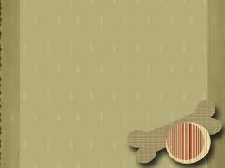
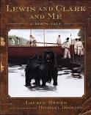
Lewis and Clark
And Me
A Dog’s Tale
By Laurie Myers
Text Talk
Bonnie Grimes Elementary

Slide 2
Docility- easy to manage

Slide 3
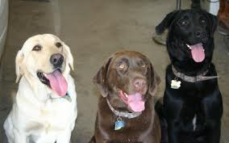
Word in Context: “… the dog was of the newfoundland breed one that I prised much for his docility and qualifications generally for my journey…”
Another example: Labs are known for their docility and sweet nature.

Slide 4
Vicious- something that is especially cruel, harsh or violent

Slide 5
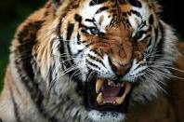
Word in context: “I took a deep breath in and started a low growl. It was not my most vicious growl, just a low, constant rumble to let the calf know he wasn’t welcome.”
Another example: The vicious tiger warned his prey before an attack.

Slide 6
Cunning- skill used in a sly or tricky way

Slide 7
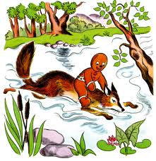
Word in context: “A new puppy comes along, all playful and cunning, and then everyone pats and plays with it. Then the big dogs jump all over themselves trying to get noticed.”
Another example: The sly and cunning fox told the Gingerbread Man to jump on his back for a ride across the river.

Slide 8
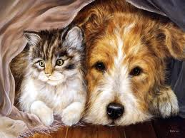
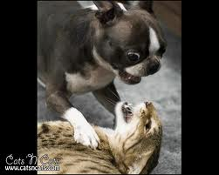
Which picture goes with docility?

Slide 9
Name 3 animals that can be vicious.

Slide 10
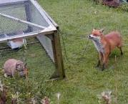
Is the fox in this photograph cunning? Tell why or why not.

